Slide 1
课件编辑说明
版本要求
本课件需用office2010及以上版本打开，如果您的电脑是office2007及以下版本或者WPS软件，可能会出现不可编辑的文档。
乱码问题
如您在使用过程中遇到公式不显示或者乱码的情况，可能是因为您的电脑缺少字体，请登录网站www.canpointgz.cn/faq下载。
联系我们
如您还有其他方面的问题，请登录网站www.canpointgz.cn/faq，点击“常见问题”，或致电010-58818058。

Slide 2

新高考版

Slide 3
命题透视
2020—2022年高考应用文写作试题分析表
年份 | 卷别 | 体裁 | 主题 | 形式
2022 | 新高考Ⅰ/Ⅱ卷 | 邀请信 | 邀请外教做访谈 | 文字提纲
 | 全国甲卷 | 倡议书 | 海洋保护 | 文字提纲
 | 全国乙卷 | 说明文 | 课堂外的英语学习方式 | 文字提纲+图表
考情分析

Slide 4
（续表）
命题透视
2020—2022年高考应用文写作试题分析表
年份 | 卷别 | 体裁 | 主题 | 形式
2021 | 新高考Ⅰ/Ⅱ卷 | 短文投稿 | 英文报Youth庆祝创刊十周年 | 文字提纲
 | 全国甲卷 | 咨询信 | 中国传统文化 | 文字提纲
 | 全国乙卷 | 发言稿 | 网络学习 | 文字提纲
考情分析

Slide 5
（续表）
命题透视
2020—2022年高考应用文写作试题分析表
年份 | 卷别 | 体裁 | 主题 | 形式
2020 | 新高考Ⅰ/Ⅱ卷 | 新闻报道 | 学校组织的越野赛跑活动 | 文字提纲
 | 全国卷Ⅰ | 记叙文 | 写一位自己尊敬的人 | 文字提纲
 | 全国卷Ⅱ | 记叙文 | 记叙和同学到农场参加的一次采摘活动 | 文字提纲
 | 全国卷Ⅲ | 求助信 | 请外教帮助指导改编的短剧 | 文字提纲
考情分析

Slide 6
（续表）
命题透视
2020—2022年高考应用文写作试题分析表
命题 规律 | 1. 写作体裁多样化。过去主要以书信和电子邮件为主,近几年出现了新闻报道、记叙文、演讲稿等,2022年全国甲、乙卷中均以短文投稿的形式出现。 2. 命题形式开放化。过去主要以单一的提纲式文字提示为主,2022年全国乙卷首次运用了“文字提纲+图表” 式的提示语。 3. 写作主题深刻化。过去主要写与考生的学习、日常活动、人际关系等相关的话题,同时关注中国传统文化和社会主义核心价值观,2022年全国甲卷“我们的海洋,我们的责任”深化到生命共同体的话题。
考情分析

Slide 7
一、解读评分标准, 明确写作任务
 | 评分标准 | 解读
第五档 21~25分 | 完全完成了试题规定的任务。 ——覆盖所有内容要点。 ——应用了较多的语法结构和词汇。 ——语法结构或词汇方面有些许错误, 但是是由尽力使用较复杂的语法结构或较高级的词汇所致;具备较强的语言运用能力。 ——有效地使用了语句间的连接成分, 使全文结构紧凑。 完全达到了预期的写作目的。 | 1.“覆盖所有内容要点”就是要求考生在写作时要认真审题, 确保要点“全而不漏”。 2. “应用了较多的词汇”是指词汇使用的多样性, 如词性的多样性、高级词汇的使用、同义词与反义词的使用、短语的使用等。
应试点睛

Slide 8
（续表）
 | 评分标准 | 解读
第四档 16~20分 | 完成了试题规定的任务。 ——虽漏掉一两个次重点, 但覆盖所有主要内容。 ——应用的语法结构和词汇能满足任务的要求。 ——语法结构或词汇方面的应用基本准确, 有些许错误主要是因尝试使用较复杂的语法结构或词汇所致。 ——应用简单的语句间的连接成分, 使全文结构紧凑。 达到了预期的写作目的。 | 3. “较复杂的语法结构”是指句式结构的多样性。毋庸置疑, 单调的句式会使文章显得呆板, 缺乏生机和活力, 而灵活多变的句式则使行文丰富多彩、生动、自然、流畅。感叹句、倒装句、复合结构、强调句型、定语从句、非谓语动词(短语)等语法结构的正确使用, 可以使文章的语言充满层次感, 从而较好地反映出考生的语言运用能力。
应试点睛

Slide 9
（续表）
 | 评分标准 | 解读
第三档 11~15分 | 基本完成了试题规定的任务。 ——虽漏掉一些内容, 但覆盖所有主要内容。 ——应用的语法结构和词汇能满足任务的要求。 ——有一些语法结构或词汇方面的错误, 但不影响理解。 ——应用简单的语句间的连接成分, 使全文内容连贯。 基本达到了预期的写作目的。 | 4. “有效地使用了语句间的连接成分, 使全文结构紧凑”是指句与句、段与段之间以一种明晰的、合乎逻辑的顺序组织与安排, 在文意与结构上层次分明、条理清楚、连贯流畅。
应试点睛

Slide 10
通过分析第三档至第五档的评分标准可知, 高分书面表达具有卷面美观化、用词高级化、句式多样化、结构复杂化、逻辑条理化等特点。
应试点睛

Slide 11
二、应用文的基本写作步骤
1. 审题。审题是应用文写作的关键步骤。考生应该通读应用文写作的文字说明,根据文字说明判断文章的体裁、人称和时态。
2. 构思。根据文章体裁构思文章的要点。构思时切记要点要全、不跑题。
3. 布局。合理安排文章的结构,应用文写作最忌讳考生不分段。考生可以根据文章体裁和写作要点提示分两段或三段完成写作。要注意书信的写作格式。
应试点睛

Slide 12
4. 撰写。考生撰写时,应该根据写作内容确定写作的语气,根据交际对象使用恰当、得体的语言。适当使用高级词汇和高级句式,使用恰当的过渡语,力求句句之间、段段之间连接紧凑,结构完整,表达清楚。
5. 检查。检查文章时,首先应该对照写作提示检查要点是否齐全,语气是否正确。然后进行语言修改,检查句子是否有拼写和语法错误。
6. 誊写。修改完成后,将其誊写在答题纸上,确保卷面整洁,书写规范,力求给阅卷老师留下良好的印象,为获得高分创造条件。
应试点睛

Slide 13
三、应用文写作的5C原则
1. 完整(completeness)
2. 清楚(clarity)
3. 礼貌(courtesy)
4. 连贯(coherence)
5. 简洁(conciseness)
应试点睛

Slide 14

第1讲
应用文类

Slide 15
应用文是高考英语写作中最常考查的一种体裁。它接近考生的实际生活, 易于表达, 能充分考查考生的写作水平。常见的应用文有书信(包括电子邮件)、通知、新闻报道、演讲稿等, 其中书信最为常见, 主要包括致歉信、致谢信、求助信、慰问信、邀请信、介绍信、自荐信、求职信, 以及答复读者的解答信和短文投稿等,体现考察形式的多样化。
专题导读

Slide 16
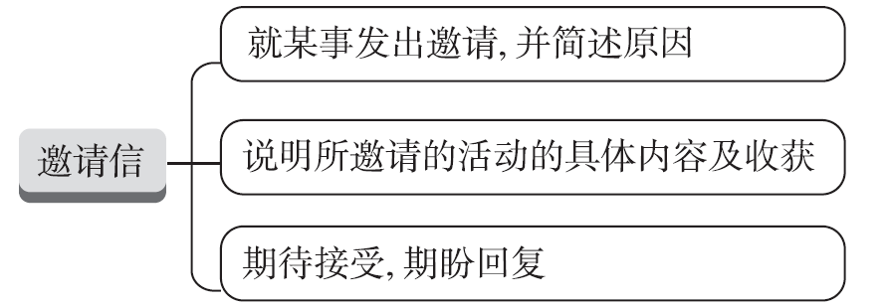
考点1 邀请信
【写作架构】
专题导读

Slide 17
【高考体验】
[2022•新高考全国Ⅰ卷]
假定你是校广播站英语节目“Talk and Talk”的负责人李华,请给外教Caroline写邮件邀请她做一次访谈。内容包括:
1. 节目介绍;
2. 访谈的时间和话题。
注意: 1. 写作词数应为80左右;
2. 请按如下格式在相应位置作答。
专题导读

Slide 18
Dear Caroline,
.
.
.
.
.
Yours sincerely,
Li Hua
专题导读

Slide 19
[经典范文]
Dear Caroline,
I'm Li Hua, the student in charge of “Talk and Talk”, an English programme in our school radio station. I am writing to ask whether you are available to be present at our programme.
As the most popular programme in the school radio station, our programme has attracted hundreds of regular listeners ever since it was set up two years ago.
专题导读

Slide 20
We invite influential people in different fields to share their thoughts with us each week. Starting at 12 o'clock on Sunday, the interview will last forty minutes, during which time you are expected to give us some recommendations on how to reduce stress.
Looking forward to your earliest reply.
Yours sincerely,
Li Hua
专题导读

Slide 21
【提分句式】
精彩开头:就某事发出邀请
1. We are planning a Spelling Bee in the school hall this Friday evening. If you are available then, we will be happy and grateful to have you there with us.
2. Knowing you have a great passion for traditional Chinese culture, I'm (写信邀请你参加) the exhibition of traditional Chinese culture in our school.
专题导读
writing to invite you to attend

Slide 22
3. I am greatly honoured/It's my honour to extend our sincere invitation to you to join us in a surprise party to be held in the nearby nursing home next Saturday for the Double Ninth Festival.
正文佳句:说明所邀请的活动的具体内容及收获
4. It will begin at 2:00 pm and last two hours, during which time 15 well-prepared contestants will deliver their speeches.
5. (按照预定时间), the festival is to be held/The festival is scheduled to take place from…to…
专题导读
As scheduled

Slide 23
6. By participating in the event, not only _______________________
__________________________(我们可以面对面交流), but also we can have a better understanding of each other.
靓丽结尾:期待接受,期盼回复
7. I ________________________________________________________________
________________(将不胜感激如果你能接受我的邀请). I'm sure it can leave a wonderful impression on you!
can we enjoy
face-to-face talks
专题导读
would appreciate it if you could accept my
invitation

Slide 24
8. Would you please let me know as soon as possible if you can accept my invitation?
9. If interested and available, please drop me a line to let me know (以便我可以提前预订). Looking forward to your arrival/presence.
专题导读
so that I can book in advance

Slide 25
【模拟演练】
假定你是李华,你校的志愿者团队准备招收新成员。请写封邮件邀请你的留学生朋友Robert参加,内容包括:
1. 招募信息;
2. 团队的活动;
3. 期待参加。
注意: 1. 词数80左右;
2. 可以适当增加细节,以使行文连贯;
3. 开头及结尾已为你写好,不计入总词数。
专题导读

Slide 26
Dear Robert,
______________________________________________________________________
______________________________________________________________________
Yours,
Li Hua
专题导读

Slide 27
One possible version:
Dear Robert,
Fully aware that you are keen on Chinese culture and enthusiastic about volunteer work, I'm writing to invite you to apply to be admitted into our school's volunteer team, since they're now recruiting new members.
Our school's volunteer team is made up of enthusiastic members, who hold various programmes on a regular basis, like visiting the home for the old.
专题导读

Slide 28
I see it as a good way for you to get exposed to Chinese culture and expect your involvement in the team. Should you be interested and get admitted, you'll find it a precious experience that leaves you many lasting memories.
Looking forward to your reply.
Yours,
Li Hua
专题导读

Slide 29
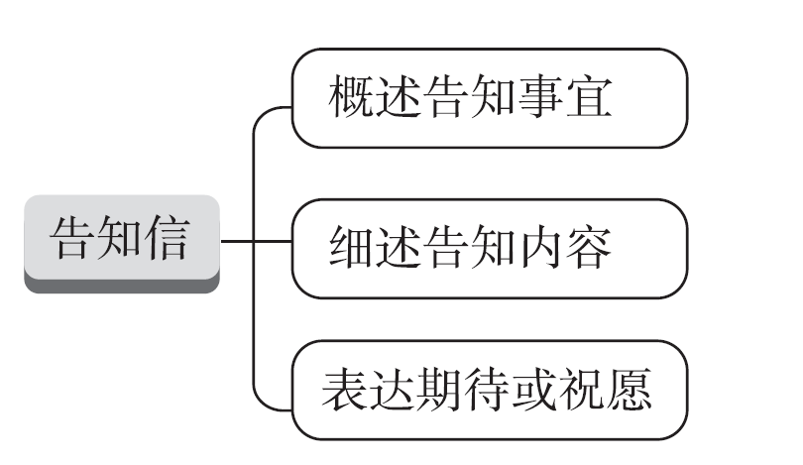
考点2 告知信
【写作架构】
专题导读

Slide 30
【高考体验】
[2019•全国卷Ⅱ]
假定你是校排球队队长李华。请写封邮件告知你的队友Chris球队近期将参加比赛, 内容包括:
1. 比赛信息;
2. 赛前准备;
3. 表达期待。
注意: 1. 词数100左右;
2. 可以适当增加细节, 以使行文连贯。
专题导读

Slide 31
[经典范文]
Dear Chris,
How is everything going? I have good news to tell you. A volleyball match is going to be held in a few weeks and our team will participate.
As for the detailed information of the match, there will be probably dozens of teams which are going to make a revolving competition. Additionally, not only can the top three teams each be awarded a medal but all the other teams taking part in it will get a reward as well.
专题导读

Slide 32
What will be the most attractive is that it will be a great honour for the top three teams to receive special volleyballs that have the name of the most popular volleyball player on them. Therefore, we must do enough preparations before the match, such as training as frequently as we can.
So excited am I that I can't wait to join in it. How about you? Looking forward to your reply.
Yours,
Li Hua
专题导读

Slide 33
【提分句式】
精彩开头:概述告知事宜
1. (了解到) you want/desire/would like to apply for voluntary work for the next Winter Olympics, I'm ready to share my experience with you without reservation.
2. ____________________________________________________________________
(得知你已经接受我们的邀请我很高兴) to participate in the coming-of-age ceremony, I'm writing to offer some brief introductions with the concrete arrangement attached/brief you about the specific arrangement.
Learning that
专题导读
Delighted/Thrilled to know that you've
accepted our invitation

Slide 34
3. I'm more than delighted to receive your letter asking me about the physical exercise in our school. Thus, I am writing to tell you some relevant details on it.
正文佳句: 细述告知内容
4. Meant/Designed/Intended/In order to help out people in need as well as enrich our school life, the club organizes/
holds/hosts/launches different kinds of/a variety of/various/a wide range of voluntary activities on a regular basis/regularly.
专题导读

Slide 35
5. (为了提高我们服务大众的意识) and helping the needy, the club offers many different activities.
6. Aimed at offering a platform for foreign students to develop an interest in Chinese, various activities will be arranged,
(从……到……)
To raise our awareness of serving the public
专题导读
ranging from…to…

Slide 36
靓丽结尾:表达期待或祝愿
7. Remember to submit your application at the school website no later than/by May 10th.
8. To be officially admitted, you are expected to fill in the application attached and send it to…
9. If you have any further questions, .
(请随意问我).
专题导读
feel free to ask me
/don't hesitate to ask me

Slide 37
【模拟演练】
假定你是李华,你的英国朋友Peter得知你校开设了名为“心灵小屋(Soul House)”的心理咨询室,来信询问其具体情况。请你给他写一封回信,内容包括:
1. 开设原因和目的;
2. 具体实施情况;
3. 效果及反馈。
注意:1. 词数80左右;
2. 可以适当增加细节,以使行文连贯。
专题导读

Slide 38
One possible version:
Dear Peter,
Delighted to know that you show an interest in the Soul House in our school, I'm honoured to inform you of the relevant details.
With a growing number of students feeling stressed out, our school set up the Soul House, aiming at relieving students' pressure and ensuring their health. It opens from 5:40 pm to 6:40 pm on weekdays.
专题导读

Slide 39
A psychologist is on duty in the room, who provides psychological expertise and guidance for students and helps resolve their mental health issues and concerns. As its name suggests, Soul House has become a place of peace for our souls and played an important role in our mental health.
Hope my account can contribute to your understanding. If you have any other questions, don't hesitate to turn to me.
Yours,
Li Hua
专题导读

Slide 40
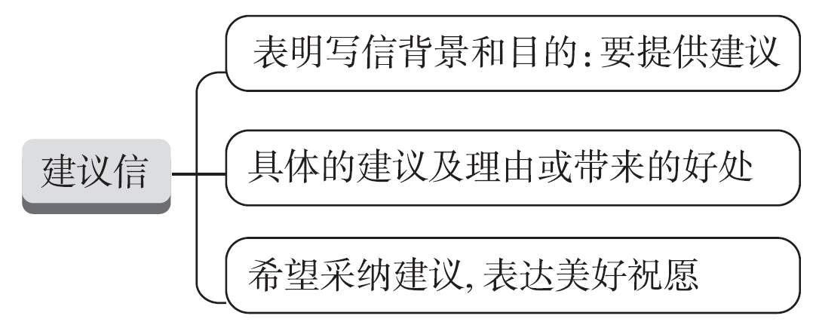
考点3 建议信
【写作架构】
专题导读

Slide 41
【高考体验】
[2011•全国卷Ⅱ]
假定你是李华,你所喜爱的Global Mirror周报创刊五周年之际征集读者意见。请你依据以下内容给主编写封信,内容主要包括:
1. 说明你是该报的忠实读者;
2. 赞赏该报优点:1)兼顾国内外新闻;2)介绍名人成功故事;
3. 提出建议:刊登指导英语学习的文章。
注意:1. 词数100左右;
2. 可以适当增加细节,以使行文连贯。
专题导读

Slide 42
[经典范文]
Dear Editor-in-Chief,
Congratulations on the 5th anniversary of Global Mirror !
I'm a regular reader of your newspaper. I like it very much mainly for the following two reasons. First, it covers both national and international news so that, by simply turning the pages, I can learn all important things that have happened during the week.
专题导读

Slide 43
Equally attractive are the success stories of world-famous people, which help me understand how a person can work hard to make the world a better place.
As a young student, I suggest that Global Mirror carry articles to guide us in our English learning, and I hope that it will become even more popular.
Sincerely yours,
Li Hua
专题导读

Slide 44
【提分句式】
精彩开头:表明写作背景和目的:要提供建议
1. (得知你遇到麻烦) in making friends, I am writing to give you some constructive suggestions/advice.
2. Concerning your request, I am more than glad to offer my advice for your reference.
Knowing you have trouble
专题导读

Slide 45
In response to
3. (回复) your letter asking me how to get along with your roommates, I'm only too willing to help and my tips/suggestions are as follows/my advice is as follows/the following are my suggestions/the following is my advice.
正文佳句:提出具体建议,并说明理由
4. Considering…,I suggest/advise that you should (not) do…
5. It could be better if…
6. In my personal opinion, it would be wise of you to do…/be a good idea to do…
专题导读

Slide 46
7. I think it would be more helpful if you could do…
8. If I were you, I would…
9. Referring to a dictionary more often is advisable________________
(以便你能获得全面的理解) the Chinese characters.
10.You'd better talk as much as possible with your classmates, thus immersing yourself in the oral-Chinese-learning atmosphere.
专题导读
so that
you can gain a comprehensive understanding of

Slide 47
Why not set aside some time to visit
11. (为什么不留出一些时间参观) museums and art galleries, where you're certain to get a deeper insight into Chinese culture?
靓丽结尾:希望采纳建议,表达美好祝愿
12. Hopefully, these suggestions would be helpful/be of great help to you/my proposals can (对……有影响) you. Looking forward to (seeing) your progress
/improvement.
专题导读
make a difference to

Slide 48
13. I sincerely hope that you _______________________________________
(将会考虑我的建议), and I look forward to your reply at your earliest convenience.
14. I will be more than glad/happy if you find my advice useful/helpful/beneficial/practical.
will take my advice into consideration/account
专题导读

Slide 49
【模拟演练】
假如你是李华,你的巴基斯坦笔友Muhammad准备明年来你校做交换生,写信向你咨询如何学习中文。请你用英语给他回封电子邮件。
要点:1. 表示欢迎;
2. 提出学习中文建议;
3. 期待与祝福。
注意:写作词数应为80左右。
;
.
.
专题导读

Slide 50
One possible version:
Dear Muhammad,
Welcome to be an exchange student at our school next year. As to how to learn Chinese, here come my tips.
First, you might as well take a Chinese course to lay a solid foundation. What's more, it is a wise choice to pick up proper Chinese TV programmes, which will enable you to access standard and authentic Chinese.
专题导读

Slide 51
Plus, befriending warm-hearted Chinese friends around you is sure to better your oral Chinese. Meanwhile, it can enrich your knowledge of Chinese customs. Finally, I suggest you try e-mailing me in Chinese.
I hope my suggestions above may benefit you. Hope you will make sufficient progress in Chinese soon. I am looking forward to your arrival.
Yours,
Li Hua
专题导读

Slide 52
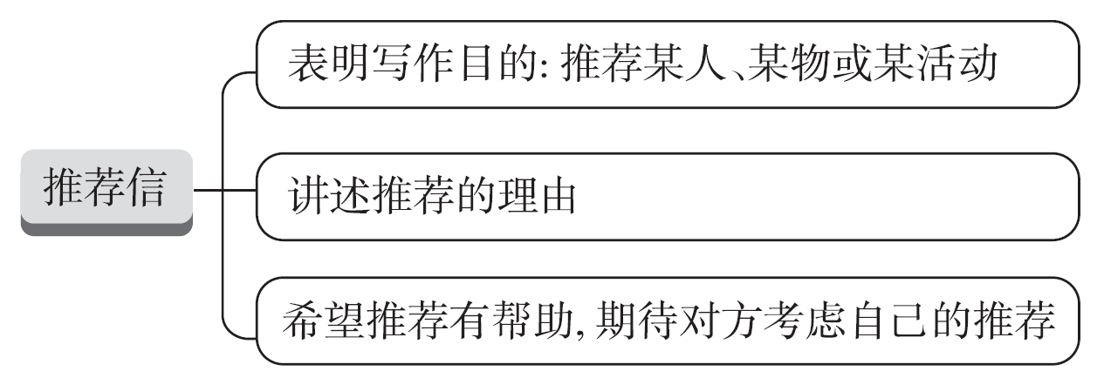
考点4 推荐信
【写作架构】
专题导读

Slide 53
【高考体验】
[2018•北京卷]
假设你是红星中学高三学生李华, 你的英国朋友Jim在给你的邮件中提到他对中国文化感兴趣, 计划明年来北京上大学。他向你咨询相关信息。请给他回邮件, 内容包括:
1. 表示欢迎;
2. 推荐他上哪所大学;
3. 建议他做哪些准备工作。
注意:1. 词数80左右;
2. 开头和结尾已给出, 不计入总词数。
专题导读

Slide 54
Dear Jim,
_____________________________________________________________________________________________________________________________________________________________________________________________________________________
Yours,
Li Hua
专题导读

Slide 55
[经典范文]
Dear Jim,
I am very glad to know that you are coming to attend university in Beijing next year. Knowing you are interested in Chinese culture, I recommend Beijing University to you, which is one of the best universities in China. Its Chinese Literature major is perfect for you where you can be completely soaked in Chinese profound history and rich culture.
专题导读

Slide 56
As for preparation, some reading in advance is needed like The Story of the Stone while some online courses of spoken Chinese can be of giant help for you to adapt into the Chinese language environment. If you still have questions, please feel free to let me know.
Looking forward to meeting you here soon.
Yours,
Li Hua
专题导读

Slide 57
【提分句式】
精彩开头:开门见山,推荐某人某物或某活动
1. (得知你对……很感兴趣) ancient Chinese architecture, I strongly recommend the Forbidden City to you.
2. I would like to present…for your consideration in your search for…
3. I'm more than delighted to recommend the table tennis club which you are curious about to you.
Knowing that you take a great interest in
专题导读

Slide 58
正文佳句:讲述推荐理由
4. The reason why I recommend…is that…
5. With rich social practice experience, he is capable of dealing with all kinds of emergencies, so I am sure he is the best person for this position.
6. Besides, it will help you learn Chinese in interesting and effective ways.
专题导读

Slide 59
靓丽结尾:希望推荐有帮助,期待对方考虑自己的推荐
7. Therefore, I (毫不犹豫地推荐她) as an ideal candidate for the post you advertised.
8. (在她的帮助下), you will surely benefit a lot.
9. I do hope that you can consider my recommendation/take my recommendation into consideration/account and it can be of great help for your decision.
do not hesitate to recommend her
专题导读
With her assistance

Slide 60
【模拟演练】
假定你是李华,你的英国笔友John对于体育锻炼产生了浓厚的兴趣,想请你推荐一项适合高中生在业余时间里进行的体育运动。请你给他写封邮件,内容包括:
1. 推荐理由;
2. 提醒进行该项运动时的注意事项;
3. 该运动带来的益处。
注意:1. 词数80左右;
2. 可以适当增加细节,以使行文连贯;
3. 开头和结尾已为你写好。
专题导读

Slide 61
Dear John,
_____________________________________________________________________________________________________________________________________________________________________________________________________________________
Yours,
Li Hua
专题导读

Slide 62
One possible version:
Dear John,
I'm glad you are interested in physical exercise. I'm writing to recommend skating to you in your spare time.
To begin with, skating can help build up your body. It can also remove stress and tension and keep you relaxed, which contributes to your physical and mental health.
专题导读

Slide 63
Besides, your sense of balance and flexibility will get improved.
You'd better choose a professional coach and a safe stadium. Take care of yourself while exercising. After all, safety always comes first. I hope you can enjoy it.
Yours,
Li Hua
专题导读

Slide 64
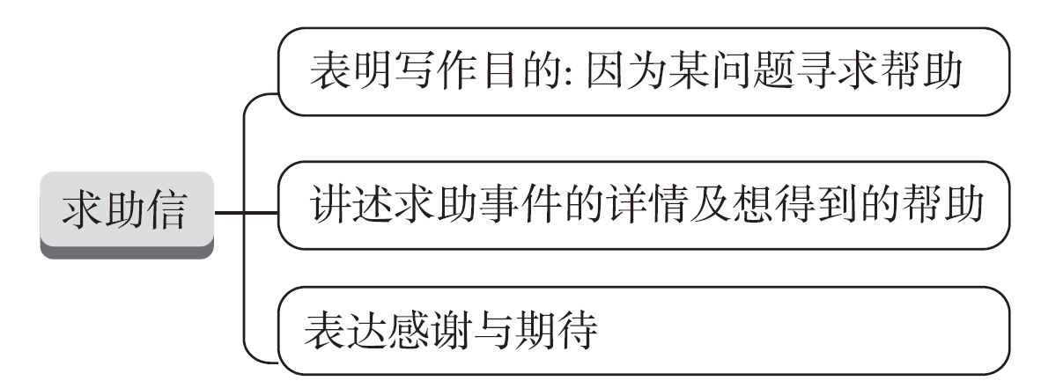
考点5 求助信
【写作架构】
专题导读

Slide 65
【高考体验】
[2016•全国卷Ⅰ]
假定你是李华,暑假想去一家外资公司做兼职,已经写好申请书和简历(résumé)。请你给外教Ms Jenkins写一封信,请她帮你修改所附材料的文字和格式(format)。要点如下:
1. 点明写信目的;
2. 详述求助内容;
3. 表示感谢。
注意:1. 词数 80 左右;
2. 可以适当增加细节,以使行文连贯。
专题导读

Slide 66
[经典范文]
Dear Ms Jenkins,
I'm Li Hua, a student from your English writing class last term. I'm writing to ask for your help.
I'm applying for a part-time job in a foreign company in my city during the summer vacation, and I have just completed my application letter and résumé. However, I am not quite sure of the language and the format I've used.
专题导读

Slide 67
I'd be extremely grateful if you could take some time to go through them and make necessary changes. I'm looking forward to your early reply.
Yours truly,
Li Hua
专题导读

Slide 68
【提分句式】
精彩开头: 表明写作目的:因为某问题寻求帮助
1. I'm writing to ask you for help/to ask you to do me a favour.
2. I'm writing in the hope that you will be kind enough to do me a favour.
3. I'm Li Hua, a high school student. .
(我写信请求你的帮助) with the contents of the magazines which are suitable for us high school students.
专题导读
I'm writing to ask you for some help

Slide 69
正文佳句:讲述求助事件的详情及想得到的帮助
4. To begin with, I don't feel quite accustomed to/can't adapt/adjust to the life here.
5. I (在……方面有困难) fitting into/find it difficult to fit into the new life in a new country,
(这非常困扰我). So I have no choice but to turn to you for help.
6. (面对如此多的困难), I wonder if you could do me a favour and help with the preparation of the upcoming Sino-Ireland Cultural Festival.
专题导读
have some difficulty in
which bothers me a lot
Faced with so many difficulties

Slide 70
靓丽结尾:表达感谢与期待
7. Thanks for your kindness in advance./Thank you very much for the favour you'll do to me.
8. I wonder if you can help us with these difficulties. We would appreciate it/be grateful/thankful if you could lend us a hand.
9. Thanks for your time and I'm looking forward to your early reply.
专题导读

Slide 71
【模拟演练】
假定你是李华,正在新西兰某校做交换生。为了弘扬中国传统音乐,你校来自中国的交换生将举办一场音乐会。请给好友 Fred 写封邮件,请他就有关事宜给予帮助,内容包括:
1. 举办目的;
2. 求助内容;
3. 约定时间和地点。
注意:1. 词数 80 左右;
2. 可以适当增加细节,以使行文连贯。
专题导读

Slide 72
One possible version:
Dear Fred,
I wonder if you could do me a favour and help with the preparation of the concert to be held in our school.
The concert aims to help foreign students learn more about traditional Chinese music. First, I'd appreciate it if you could help advertise it.
专题导读

Slide 73
Moreover, lacking some equipment, I sincerely hope you can contact the school music club so they can provide some for us.
I wonder if it's convenient for us to have a discussion together in our classroom tomorrow afternoon. With your generous help, I believe the concert will be unforgettable.
Thanks for your time and I'm looking forward to your early reply.
Yours,
Li Hua
专题导读

Slide 74
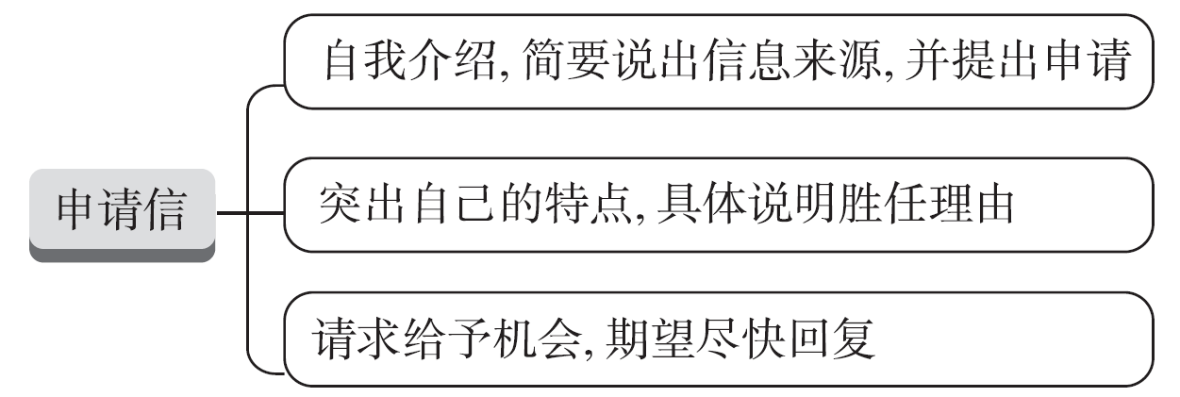
考点6 申请信
【写作架构】
专题导读

Slide 75
【高考体验】
[2019•全国卷 I]
假定你是李华,暑假在伦敦学习,得知当地美术馆要举办中国画展。请写一封信申请做志愿者,内容包括:
1. 写信目的;
2. 个人优势;
3. 能做的事情。
注意:1. 词数100左右;
2. 可以适当增加细节,以使行文连贯。
专题导读

Slide 76
[经典范文]
Dear Sir/Madam,
I'm Li Hua, an exchange student from China during this summer vacation. So thrilled am I to be informed that volunteers are wanted for the upcoming Chinese painting exhibition. Being a volunteer has long been my dream, so I'm writing to apply for the position.
The reasons are as follows. First, I am fluent in both English and Chinese. So it is easy for me to communicate with foreigners and Chinese.
专题导读

Slide 77
Second, being a monitor makes me a brilliant organizer, which will help to keep the exhibition in order. The most important factor is that my relevant knowledge will undoubtedly help the audience learn more about the unique Chinese art form.
All in all, my sense of responsibility will make me a qualified volunteer. I would appreciate it if you could take my application into consideration.
Yours,
Li Hua
专题导读

Slide 78
【提分句式】
精彩开头:自我介绍,简要说明信息来源,并提出申请
1. In reply to your advertisement in Youth, ______________________
(我申请成为一名志愿者) for a Chinese painting exhibition to be held in the local art gallery.
2. I am extremely pleased to see your advertisement for an English tutor in the newspaper.
I'm writing to
apply to be a volunteer
专题导读

Slide 79
3. I am really delighted to learn that a guide for your Chinese cultural relic exhibition is wanted and_______________________________
(我写信申请参与的机会).
正文佳句:突出自己的特点,具体说明胜任理由
4. In the first place, I have strong written and spoken communication skills.
5. I do believe that I (胜任这项工作). Firstly, I have extensive knowledge of our school's history and culture.
I'm writing to apply for a chance to get involved
专题导读
am qualified/fit for the job

Slide 80
6. Last but not least, I have a good personality, and I am independent in life.
靓丽结尾:请求给予机会,期待尽快回复
7. (希望), I could be offered the chance to join you/be accepted as a member of your summer camp.
8. I do hope that I can meet your requirements.
9. I would appreciate it if you could take my application into consideration. Looking forward to (收到你的来信) as soon as possible.
专题导读
Hopefully
hearing from you

Slide 81
【模拟演练】
假定你是李华,你所在的社区图书馆正在招聘暑期志愿者。请写一封申请信,内容包括:
1. 写信目的;
2. 个人优势;
3. 能做的事情。
注意:1. 词数 80 左右;
2. 可以适当增加细节,以使行文连贯。
专题导读

Slide 82
One possible version:
Dear Sir or Madam,
I am writing to apply for a volunteer position in our community library during the summer break.
As a graduating high school student who has a passion for volunteering, I will have enough time and energy to invest into my community. Besides, I am an enthusiastic, reliable and responsible person.
专题导读

Slide 83
Not only can I organize books on the shelves, but also I can assist library users in finding what they want. I am sure that I can deliver excellent library service to our readers.
I would appreciate it if you could offer me the opportunity.
Looking forward to your earliest reply.
Yours,
Li Hua
专题导读

Slide 84
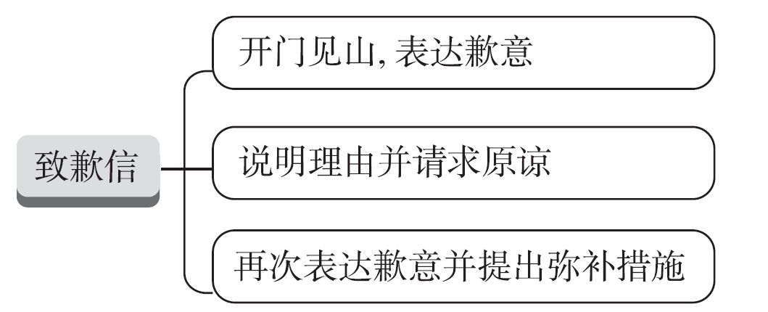
考点7 致歉信
【写作架构】
专题导读

Slide 85
【高考体验】
[2021•北京卷]
假设你是红星中学高三学生李华。你和英国好友Jim原定本周末一起外出,你因故不能赴约。请你用英文给他写一封电子邮件,内容包括:
1.表达歉意并说明原因;
2.提出建议并给出理由。
注意:1.词数100左右;
2.开头和结尾已给出,不计入总词数。
专题导读

Slide 86
Dear Jim,
_____________________________________________________________________________________________________________________________________________________________________________________________________________________
Yours,
Li Hua
专题导读

Slide 87
[经典范文]
Dear Jim,
I'm terribly sorry to inform you that I am not able to accompany you this weekend as planned. I've just been told that I have to go and visit my sick grandfather in the countryside, who was suddenly admitted to the hospital. I hope the change won't cause you too much trouble.
专题导读

Slide 88
How about going out next Saturday morning? If it's convenient for you, let's meet at the school gate at 9:00. Please let me know what time suits you best. I should be available anytime next weekend.
Please accept my sincere apology. I am looking forward to your prompt reply.
Yours,
Li Hua
专题导读

Slide 89
【提分句式】
精彩开头: 开门见山,表达歉意
1. I feel terribly sorry that I forgot/failed to…
2. I would like to (表达我的歉意) for not being able to…
3. I am writing this letter to express my regret…
4. I'm writing to sincerely make an apology/apologize for having broken your rare vase.
专题导读
express my apologies

Slide 90
5. ;
(我写信来为我不能参加……向你表达歉意) the “Traditional Chinese Culture Day” activity to be held on the Saturday morning with you as we planned last week.
6. I'm sorry that I can't return the English magazine to you on Saturday afternoon as scheduled.
7. I'm terribly/awfully sorry that I can't make it to Beijing with you next weekend (正如我们此前计划的).
I'm writing to apologize to you for not being able to participate in
专题导读
as we planned before

Slide 91
正文佳句:说明理由并请求原谅
8. On my way home yesterday, I got caught in the heavy rain and I had a bad cold.
9. Therefore, I will__________________________________________________ (不得不在机场接他). After all, it's been more than one year since we saw each other last time.
10. Because of/Owing to/Due to/On account of my tight schedule for the final examinations, I _______________________________
(我无法腾出时间来帮助你) with your oral English.
专题导读
have to pick him up at the airport
failed to spare some
time to help you

Slide 92
How I wish I could join in the activity
11. (我多么希望我能参加这个活动), but I am afraid I will not be available because I'll have to go to Beijing for a contest on the morning of Saturday.
12. The reason why I failed to keep my promise/word was that I had an important meeting to attend then.
13. What troubled me most was that I missed the very flight,
(这导致了我缺席).
专题导读
which led to my absence

Slide 93
14. I am awfully sorry for breaking my promise and I apologize for any inconvenience it brings to you. I hope you can understand me.
15. Excuse me for my delay in turning in my assignment.
靓丽结尾:再次表达歉意并提出弥补措施
16. I sincerely hope that you will (接受我的道歉).
17. Please accept my sincere apology and deep regret for failing to attend your lecture.
专题导读
accept my apology

Slide 94
18. Once again, I am sorry for any inconvenience caused.
19. Maybe we can fix another time to next weekend as long as you are available.
20. So (你是否方便) if we meet next Monday morning? If not, please let me know what time suits you best.
专题导读
is it convenient for you

Slide 95
【模拟演练】
假如你是李华,你的朋友Tom邀请你下周去他们学校参加文化交流活动并向外国朋友介绍中国的传统绘画。但你忙于准备高考,不得不谢绝邀请。请你用英语给他写一封信,内容包括:
1. 谢绝邀请;
2. 说明理由;
3. 推荐朋友Mary参加,并说明原因。
注意:1. 词数80左右;
2. 可以适当增加细节,以使行文连贯。
专题导读

Slide 96
One possible version:
Dear Tom,
Thank you very much for your invitation.
I had planned to take this opportunity to introduce the traditional Chinese painting to foreign friends, but I'm sorry to inform you that I can't make it. The reason for my absence is that I have been engaged in preparing myself for the college entrance examination.
专题导读

Slide 97
I strongly recommend my friend Mary to take my place next week. She began to learn painting at an early age and has a good knowledge of the traditional Chinese painting, which, together with her active personality and perfect spoken English, will help make your activity a success.
Sorry again for any inconvenience caused.
Yours,
Li Hua
专题导读

Slide 98
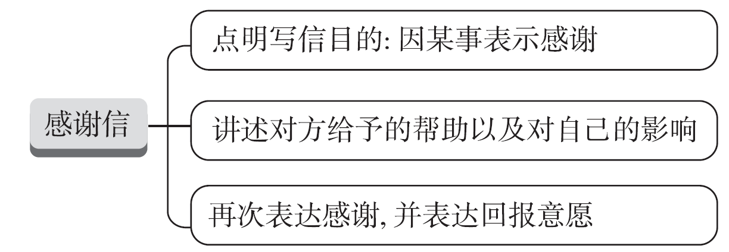
考点8 感谢信
【写作架构】
专题导读

Slide 99
【高考体验】
[2019•浙江6月考]
假定你是李华,经常帮助你学习英语的朋友Alex即将返回自己的国家。请给他写一封邮件,内容包括:
1. 表示感谢;
2. 回顾Alex对你的帮助;
3. 临别祝愿。
注意: 1. 词数80左右;
2. 可适当增加细节,以使行文连贯。
专题导读

Slide 100
[经典范文]
Dear Alex,
Learning that you're leaving for the United States soon, I'm eagerly writing to express my heartfelt gratitude to you for your help.
Honestly speaking, it's so nice of you to offer me some practical learning skills. Under your professional guidance, I have made such unbelievable progress in English.
专题导读

Slide 101
It's indeed a pleasant surprise for me to even rank first in a recent English speech contest. Whenever I encounter difficulties, you always cheer me up and help me out, which fuels my enthusiasm for English and boosts my confidence. No words are strong enough to convey how grateful I am.
Thanks again and wish you a pleasant journey home.
Yours,
Li Hua
专题导读

Slide 102
【提分句式】
精彩开头:点明写信目的(因某事表示感谢)
1. On behalf of…, I'd like to extend/convey/express my sincere/heartfelt gratitude/appreciation for your selfless help with…
2. I'm extremely grateful/thankful to you for your unselfish assistance during…
专题导读

Slide 103
3. Knowing that I've been admitted to the Harvard University's Exchange Project in the summer vacation, __________________________
(我写信来感谢你的指导和鼓励).
正文佳句:讲述对方给予的帮助以及对自己的影响
4. But for/Without your help, the performance .
(不会如此成功).
I'm writing to thank you for your guidance and encouragement
专题导读
couldn't
have been so successful

Slide 104
5. What benefits/impresses me most is your selfless guidance on my English pronunciation, which not only equips me with the ability to express myself fluently, but also ___________________________
(增加我面对挑战的信心).
6. Your warmth has made our brief stay in London pleasant and memorable.
boosts my confidence to face up to the challenge
专题导读

Slide 105
靓丽结尾:再次表达感谢,并表达回报意愿
7. My true gratitude is beyond any words/description.
8. Please (接受我真诚的感谢) for your generous help, which I will never forget.
9. I hope you will come to visit China in the future and I can return/repay your kindness.
accept my sincere thanks
专题导读

Slide 106
【模拟演练】
假定你是李华,刚结束在英国为期一个月的学习。学习期间,你和房东Mr Smith结下了深厚的友谊。请用英语给Mr Smith发一封邮件,内容要点如下:
1. 对Mr Smith表示感谢;
2. 希望保持联系;
3. 邀请他来中国游玩。
注意:1. 词数80左右;
2. 可以适当增加细节,以使行文连贯。
专题导读

Slide 107
One possible version:
Dear Mr Smith,
How time flies! I've been back home. How I miss the days we spent together!
It was your help and kindness that made my study and life in the UK special and enjoyable. Without your help, I wouldn't have got used to the life there that quickly. I still miss the delicious meals you prepared for me.
专题导读

Slide 108
Besides, I am really grateful for your patience while you are talking with me. It was a wonderful time for me to improve my spoken English.
I hope we can stay in touch with each other. Welcome to my country in the near future.
Best wishes.
Yours,
Li Hua
专题导读

Slide 109
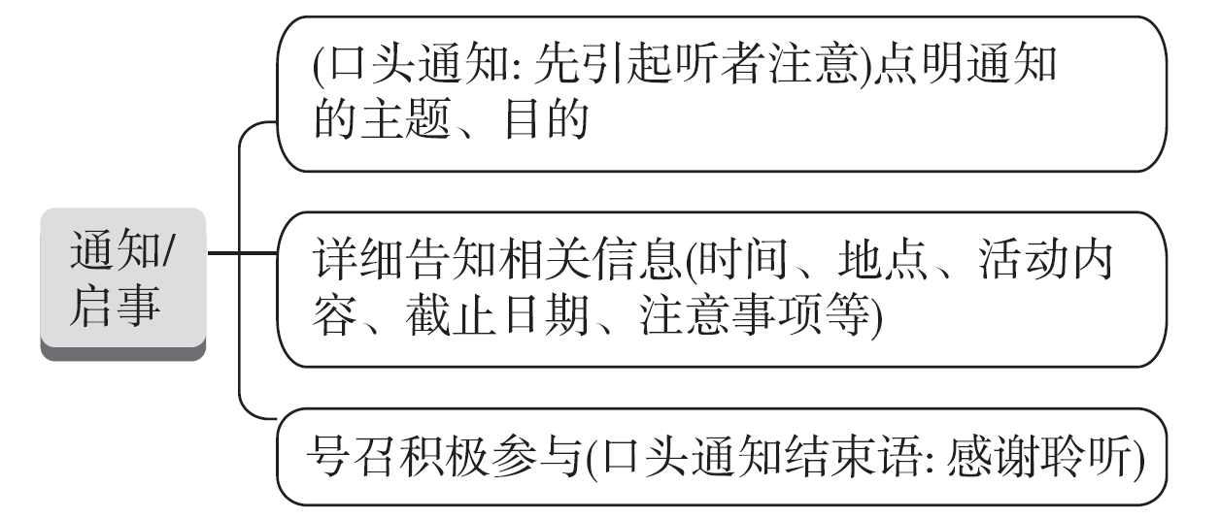
考点9 通知/启事
【写作架构】
专题导读

Slide 110
【高考体验】
[2018•全国卷Ⅱ]
你受学生会委托为校宣传栏“英语天地”写一则通知, 请大家观看一部英文短片Growing Together, 内容包括:
1. 短片内容:学校的发展;
2. 放映时间、地点;
3. 欢迎对短片提出意见。
注意:1. 词数100左右;
2. 可以适当增加细节, 以使行文连贯。
专题导读

Slide 111
[经典范文]
Notice
In order to have a better understanding of our school, an outstanding English short movie about our school will be shown in the library from 2:30 to 4:00 in the afternoon on June 9th. It is organized by the Student Union. Here are some relevant details about it.
专题导读

Slide 112
To begin with, the name of the movie is Growing Together, which is about the development of our beloved school. As we all expect, it will be not only meaningful but also interesting. What's more, everyone of you will be welcome to take part/participate in it, enjoying the movie, having a heated discussion afterwards and giving your own comments.
The Student Union
June 8, 2018
专题导读

Slide 113
【提分句式】
精彩开头:(口头:先引起听者注意)点明通知的主题、目的
1. Attention please, everybody! I have something important to tell you. In order to promote traditional Chinese culture, our school will arrange for the exchange students to pay a visit to the Chinese Painting Exhibition.
2. To celebrate the approaching New Year, a New Year party
(按计划将被举行) in the school music hall on January 1st.
专题导读
is scheduled to be held

Slide 114
正文佳句:详细告知相关信息(时间、地点、活动内容、截止日期、注意事项等)
3. As scheduled, a wide variety of performances featuring traditional Chinese culture will be put on stage, including folk music, traditional Chinese operas, cross talk, lion dance and Chinese martial arts.
专题导读

Slide 115
4. Everybody (欢迎参加). Those who are athletic can sign up for track and field events to win glory for their class. And a volunteer group is meant for whoever is not gifted in sports but still keen on participating to help make this important activity a great success.
5. Those who are interested can contact the Student Union for further information.
is welcome to take part
专题导读

Slide 116
6. All the participants are supposed to register before this Friday if interested.
7. Participants are required to be there 10 minutes earlier and while watching the film, please keep quiet and clean.
8. Whoever feels interested and has a passion for Chinese culture, please _______________________________________________________
(尽快报名参加比赛).
9. Be sure to be there on time./Everyone is required to be present on time.
专题导读
sign up for the contest as soon as possible

Slide 117
靓丽结尾:号召积极参与(口头通知结束语:感谢聆听)
10. Looking forward to (你的积极参与). That's all. Thank you.(口头通知)
11. Don't miss the chance!
12. Everybody is expected to attend it/is welcome to take part.
your active participation
专题导读

Slide 118
【模拟演练】
假定你是李华,是某国际学校学生会主席,你校近期将在线上举办外国学生华语歌曲演唱比赛。请你用英文写一则通知,向在校留学生征集歌曲视频作品,内容包括:
1. 比赛目的;
2. 作品要求;
3. 作品提交时间和方式。
注意:1. 词数80词左右;
2. 可适当增加细节,以使行文连贯。
专题导读

Slide 119
One possible version:
Notice
To enrich extra-curricular cultural life of international students, the online Chinese Songs Singing Competition will be launched. The related information is as follows.
Participants are free to sing their favourite Chinese songs, whose content should be positive, reflecting the vitality of students. Solo performances are required.
专题导读

Slide 120
Every submission needs to be recorded in a video format of MP4 within five minutes. Please send your work to Student Union @126.com before May 15th. Top ten winning songs will be selected and displayed on the school website. Welcome to showcase your passion and talent for music.
The Student Union
专题导读

Slide 121
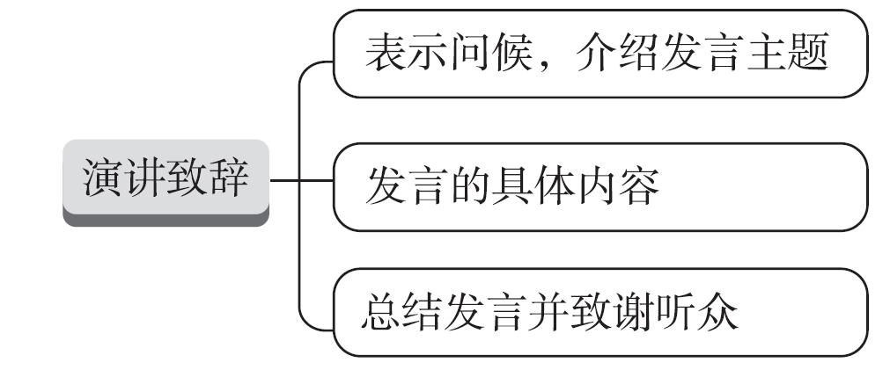
考点10 通知/启事
【写作架构】
专题导读

Slide 122
【高考体验】
[2021•全国乙卷]
你校将举办英语演讲比赛。请你以Be smart online learners为题写一篇发言稿参赛,内容包括:
1. 分析优势与不足;
2. 提出学习建议。
注意:1. 词数100左右;
2. 题目和首句已为你写好。
专题导读

Slide 123
Be smart online learners
Online learning has been an important way in study __________
_____________________________________________________________________________________________________________________________________________________________________________________________________________________
专题导读

Slide 124
[经典范文]
Be smart online learners
Online learning has been an important way in study ever since the outbreak of COVID-19.
Obviously, online learning makes study more convenient and efficient. Nearly all the courses are accessible to us. Furthermore, the time that would otherwise be spent on transport during school days can be saved to study. However, online learning can also be disadvantageous.
专题导读

Slide 125
Courses are frequently interrupted due to the bad Internet connection. Besides, some students may not concentrate on the lessons without being monitored by the teachers face-to-face.
To be a smart online learner, I suggest we communicate with the teachers whenever necessary and focus on what the teachers say. Replay the teaching video after class if we have difficulty with the subjects. I am convinced online learning will bring us as many benefits as school learning does.
专题导读

Slide 126
【提分句式】
精彩开头:表示问候,介绍发言主题
1. Good morning, boys and girls! I'm glad/honoured/privileged to have the opportunity to share my topic with you. I shall be speaking today about online learning.
2. It's a great honour/privilege for me to stand here and make/deliver/give a speech/deliver/give an address entitled/with the title of “Follow the lead”.
专题导读

Slide 127
3. I feel greatly privileged to stand here, on behalf of the whole class, _________________________________________________________________
(来表达我们热烈的欢迎/由衷的感谢) our honourable guest, Mr Smith.
正文佳句:发言的具体内容
4. To better achieve my dream, I've made boundless preparations, equipping myself with medical knowledge and studying hard to gain access to a great medical university.
to extend our warm welcome/heartfelt gratitude to
专题导读

Slide 128
I have to remind all of you here
5. Now (我必须提醒你们所有人) that the single drop of water is never as clean as before, for it has been polluted severely by our human beings.
6. I sincerely hope that we can work together to reduce global pollution.
专题导读

Slide 129
靓丽结尾:总结发言并致谢听众
7. The world around us is so beautiful. There is no reason why we don't enjoy it.So,everybody,let's choose to be happy every day!That's all. Thank you.
8. In a word, listening can really enable us to get closer to each other.Thanks for your listening/attention/time.
9. Let me conclude my speech with…
专题导读

Slide 130
【模拟演练】
假定你是李华,即将参加学校组织的主题为“My Future Career”的英语演讲比赛,请你根据以下要点写一篇演讲稿,内容包括:
1. 你的职业规划;
2. 选择理由;
3. 你为此做的准备。
注意:1. 词数80左右;
2. 可适当增加细节,以使行文连贯。
专题导读

Slide 131
One possible version:
Good afternoon, ladies and gentlemen!
I'm greatly honoured to be here to share my ideas about my future career.
If possible, I want to be a teacher in the countryside. Born and raised in a rural village, where limited educational resources and qualified teachers are available, I know teachers are badly needed there.
专题导读

Slide 132
Challenging as it may be, I'll make every effort to teach them advanced knowledge and help them get rid of poverty. To get better prepared, I will work hard to be admitted into a normal university, hopefully laying a solid foundation for my future career.
Thank you.
专题导读

Slide 133
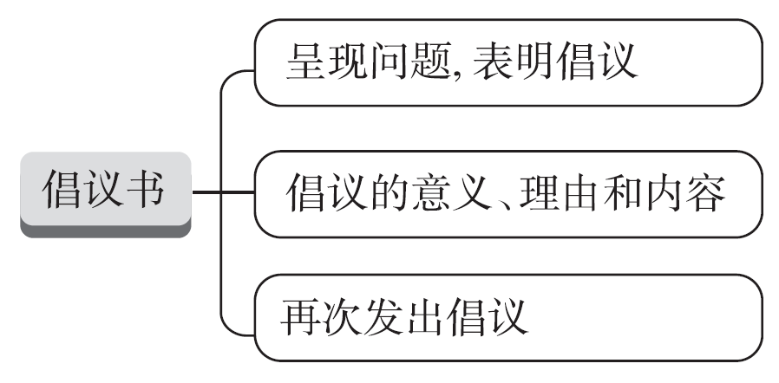
考点11 倡议书
【写作架构】
专题导读

Slide 134
【高考体验】
[2022•全国甲卷]
你校将以六月八日世界海洋日为主题,举办英语征文比赛,请你写一篇短文投稿。内容包括:
1. 海洋的重要性;
2. 保护海洋的倡议。
注意:1. 词数100左右;
2. 短文的题目和首句已为你写好。
专题导读

Slide 135
Our oceans, our responsibility
June 8th was officially named by the UN in 2009 as World Oceans Day.__________________________________________________________
_____________________________________________________________________________________________________________________________________________________________________________________________________________________
专题导读

Slide 136
[经典范文]
Our oceans, our responsibility
June 8th was officially named by the UN in 2009 as World Oceans Day. It was set up to raise our awareness of protecting the ocean.
As we all know, the ocean plays an important role in our life. Not only does the ocean offer us sufficient food, but also it maintains the balance of nature.
专题导读

Slide 137
So, it is vital for us to protect the ocean. First, what we can do is regulate our daily actions.
For example, garbage can't be thrown into the ocean. Besides, we can hand out leaflets to advocate protecting the ocean. The more people are involved, the better the ocean environment will be.
It is high time that we protected the ocean. To protect the ocean is to protect ourselves.
专题导读

Slide 138
【提分句式】
精彩开头:呈现问题,表明倡议
1. It's common to see that with College Entrance Examination approaching, many of us Senior Three are under much pressure from study, so we sincerely appeal to/call on us all to say no to the unhealthy lifestyle.
2. There exists a problem/phenomenon that many high school students don't have enough sleep. Thus, I strongly advocate that we students should sleep regularly and get enough sleep to enjoy a healthy life.
专题导读

Slide 139
正文佳句:倡议的意义、理由和内容
3. Please (记住……) a small action can make a huge difference.
4. It's of great importance/significance for us all to make a reasonable plan for our future.
5. To solve this problem, we should do as follows. Firstly, we'd better use less electric products while learning so that we can have more time to improve our handwriting. Additionally, it's necessary that we form the habit of practising calligraphy every day.
keep in mind that
专题导读

Slide 140
靓丽结尾:再次发出倡议
6. Such measures/steps can surely improve air quality, so let's start from now on.
7. We would like all of you to attach importance to saving food. Only in this way can we overcome such disturbing difficulties.
8. Every effort counts/matters/makes a difference. Let's work together/join hands to make the world a better place.
专题导读

Slide 141
【模拟演练】
随着科技的发展, 几乎每个高中生都有自己的微信号, 交流特别方便。但很多学生花太多的时间用微信和朋友聊天。假设你是学生会主席李华, 请你以学生会的名义给全校学生写一份英文倡议书, 倡议大家减少使用社交媒体的时间。内容包括:
1. 倡议的目的;
2. 过度使用社交媒体的危害;
3. 发出倡议。
专题导读

Slide 142
注意: 1. 词数80左右;
2. 可适当增加细节, 以使行文连贯。
参考词汇:社交媒体social media
____________________________________________________________________________________________________________________________________________________________________________________________________________________________________________________________________________________________
专题导读

Slide 143
One possible version:
Dear all,
I'm Li Hua, chairman of the Students' Union. I'm writing to advocate all the students reduce the time of using social media on behalf of the Students' Union of our school.
Recent years have witnessed the high development of science and technology, bringing great convenience to our daily communication.
专题导读

Slide 144
However, it is not uncommon that quite a few students attach too much importance to their “virtual” friends on social media, influencing their relationship with friends in real life. Worse still, social media has occupied too much of their spare time, even their study time, doing harm to their academic results.
Please be aware of the problem. Let's use social media properly and limit our time on it.
The Students' Union
专题导读

Slide 145
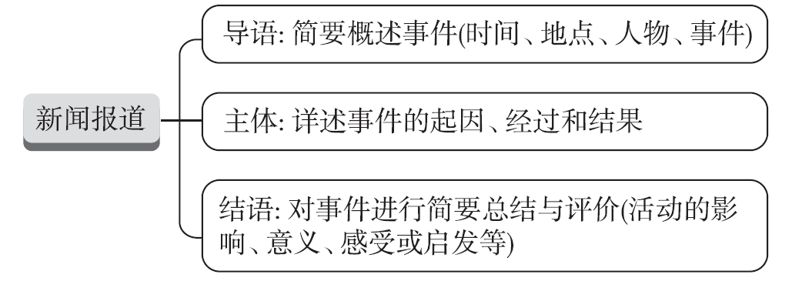
考点12 新闻报道
【写作架构】
专题导读

Slide 146
【高考体验】
[2020•全国新高考Ⅰ卷]
假定你是李华, 上周日你校举办了5公里越野赛跑活动。请你为校英文报写一篇报道, 内容包括:
1. 参加人员;
2. 跑步路线:从校门口到南山脚下;
3. 活动反响。
注意:1. 写作词数应为80左右;
2.请按如下格式在相应位置作答。
专题导读

Slide 147
A cross-country running race
____________________________________________________________________________________________________________________________________________________________________________________________________________________________________________________________________________________________
专题导读

Slide 148
[经典范文]
A cross-country running race
Last Sunday witnessed an extraordinary cross-country running race, which nearly drew the attention of every student and teacher of our school.
The students selected from every class took part in the competition. The route measured five kilometres, from our school gate to the foot of Nanshan Mountain.
专题导读

Slide 149
Every participant tried their best to finish the task, with their classmates along the way giving them necessary help as well as encouragement. At last, all the runners managed to arrive at the finish line, receiving cheers in all directions.
The activity was highly spoken of, because not only did it provide chance for us to exercise, but also made us a more cohesive class.
专题导读

Slide 150
【提分句式】
精彩开头:(导语)简要概述事件(时间、地点、人物、事件)
1. (为了增进相互了解), we had an online class with a sister school in the UK, introducing traditional festivals to each other.
2. Last Wednesday afternoon, our class took part in/participated in/joined in labour practice on Hong Xing farm.
To enhance mutual understanding
专题导读

Slide 151
took place
/was held
3. Last Wednesday, a thrilling tug-of-war___________________________
(举行) on the school playground, which attracted lots of attention./Last Wednesday (见证) an exciting tug-of-war kicking off on the playground of our school, attracting lots of attention.
正文佳句:(主体)详述事件的起因、经过和结果
4. A variety of activities, fun and exciting, attracted lots of participation, among which dumpling making was most welcomed.
witnessed/saw
专题导读

Slide 152
did the students perform
5. Not only (学生们表演了) antique musical instruments, Chinese painting and calligraphy, but they also did kung fu and t'ai chi, which undoubtedly drew these foreign visitors' attention.
6. (既兴奋又好奇), all the students immersed themselves in the fascinating programmes, offering applause enthusiastically after it wrapped up.
专题导读
Thrilled and curious

Slide 153
靓丽结尾:(结语)对事件进行简要总结与评价(活动的影响、意义、感受或启发等)
7. The show was well received/was highly thought of/was sung high praises for.
8. The event turned out to be a hit/a great success and we are longing for another exchange programme in the near future.
9. It is surely a rewarding experience, which not only enables us to learn a lot that is beyond our textbooks but also promotes the friendship among us.
专题导读

Slide 154
【模拟演练】
假定你是李华,应约为某英文网站写一则简讯,报道你校今天刚结束的中文诗词大赛 (Chinese Poetry Contest)。内容包括:
1. 大赛举办的目的;
2. 大赛举办的形式;
3. 大赛举办的结果。
注意:1. 词数80左右;
2. 可以适当增加细节,以使行文连贯。
专题导读

Slide 155
One possible version:
A Chinese Poetry Contest
Aimed at cultivating students' passion for Chinese poems and inspiring them to have a clear picture of traditional Chinese culture, a Chinese Poetry Contest was successfully held in our school today.
Twenty students from different classes turned up as competitors.
专题导读

Slide 156
Not only did they read poems with expression, but they also recited poems from memory. It went without saying that they all had made excellent preparations for the contest. Finally, the prizes were awarded to the winners, one top, five second and several more third.
End as the contest did, it has a far-reaching influence on us students. By attending activities of this kind, students have learned a lot about Chinese poetry and traditional culture.
专题导读

